Slide 1

Bot-a-Thon
HP Summer Scholars Group 23 July 2020

Slide 2




Topic
Automation of Reconciliation Process from Multiple Reports
Team Members
Sinan Kamil
Computer Engineering/
Science
Alek Racz
Computer Science
Kevwe Onome-Irikefe
Business Analytics
Kriti Sinha
Computer Science

Slide 3
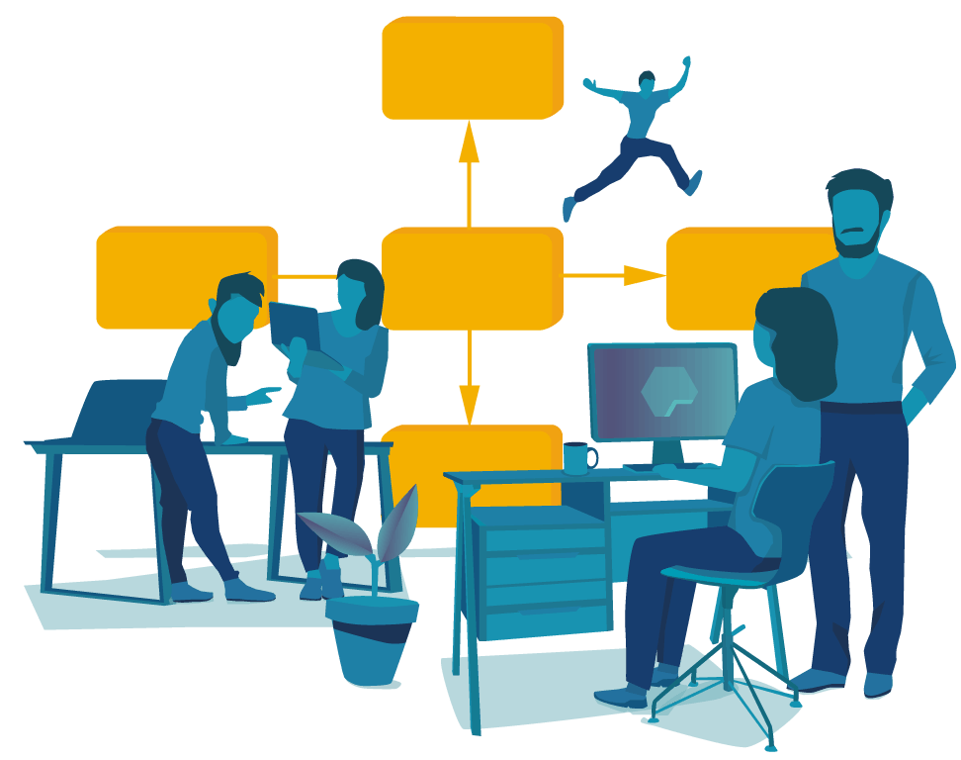
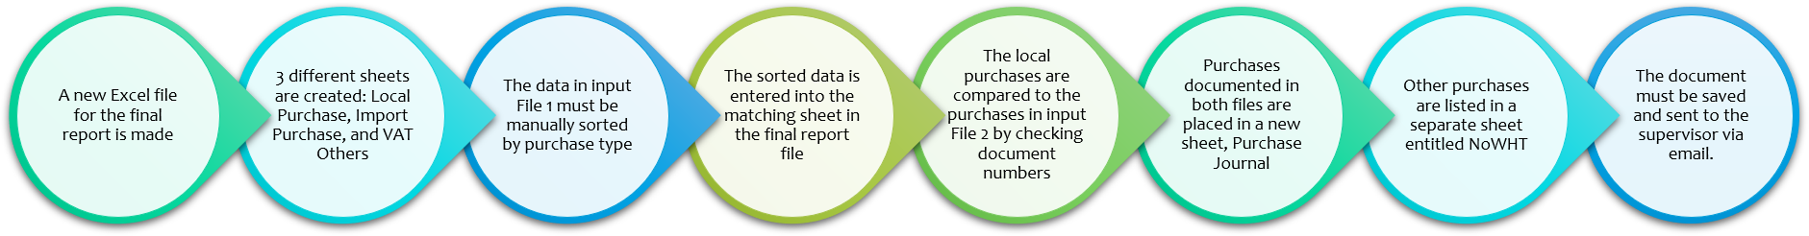
Process Background
Value Proposition
We’re struggling with reconciling multiple tax reports. Currently, it takes 10 minutes to reconcile two tax reports and send the final report via email.
We’re evaluating RPA’s capability to address our needs for reconciling tax reports. The reconciliation process touches 2 applications and 1 server.
Steps of current process
These repetitive, rule-based steps can quickly and easily be performed with 100% accuracy using Robotic Process Automation (RPA)!

Slide 4
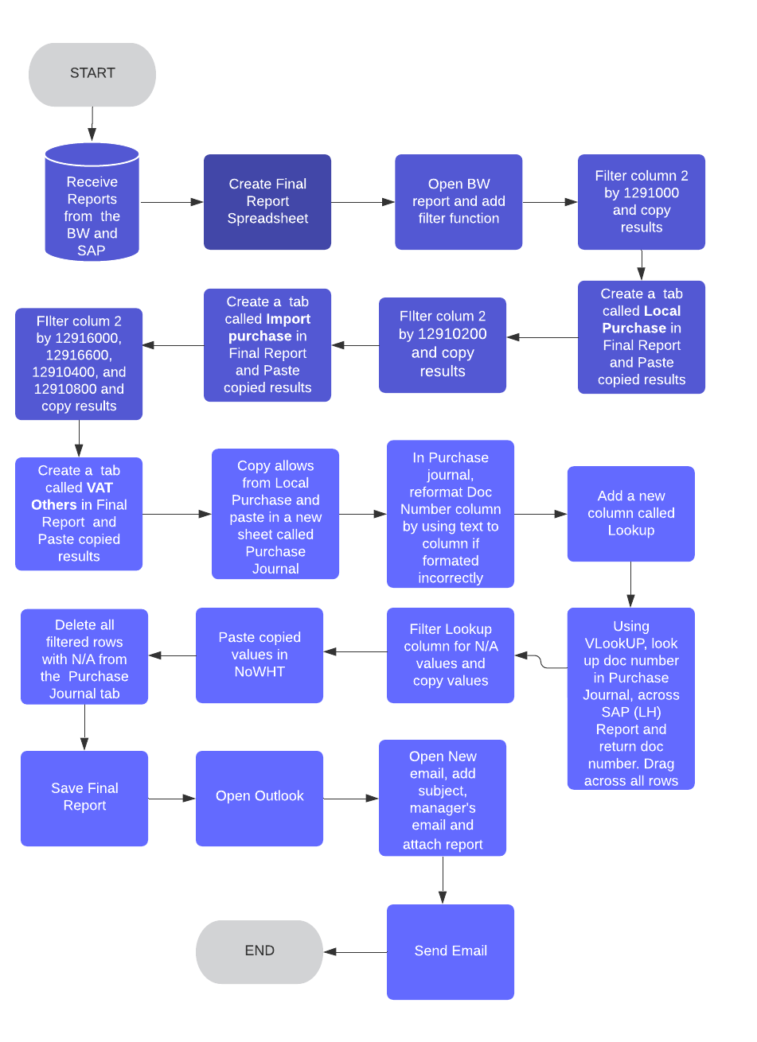
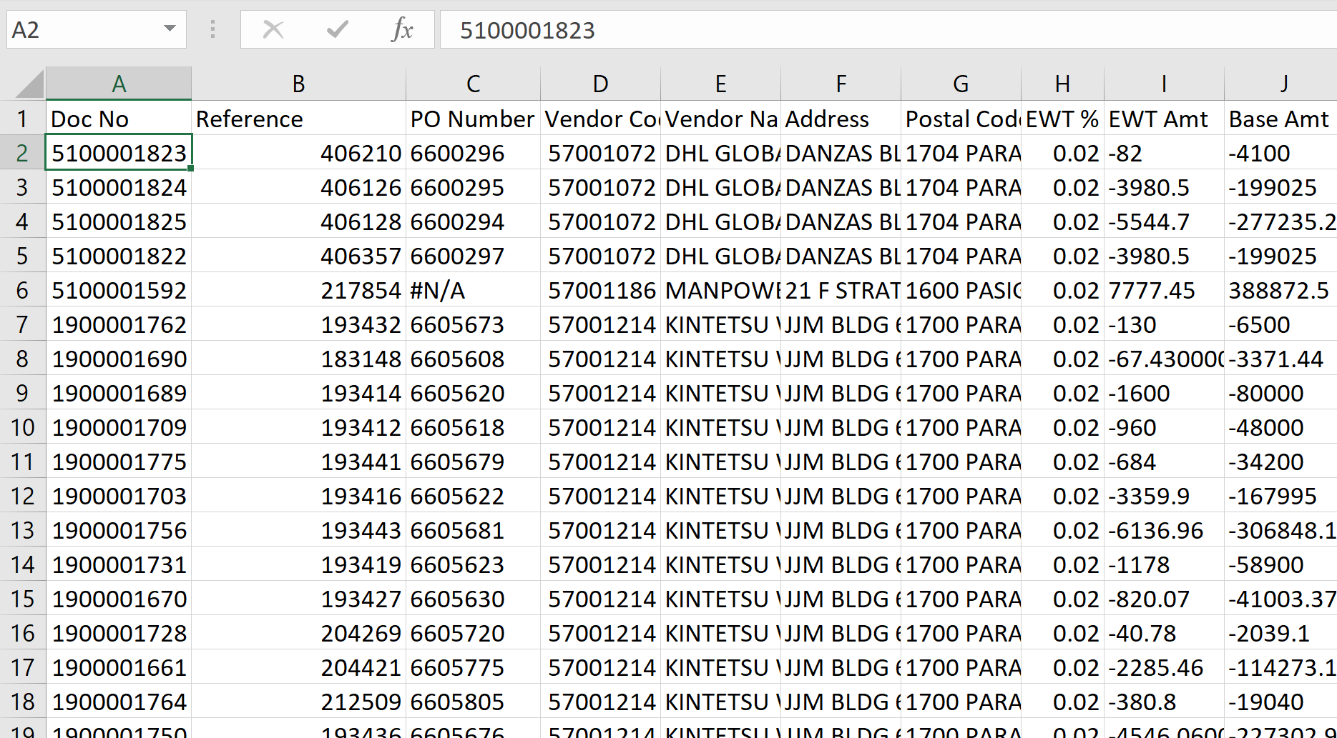
Process Background - Human Path
Left: A detailed flow chart containing each specific step performed by a human in this process
Above: Screenshot of the data that workers must manually manipulate

Slide 5
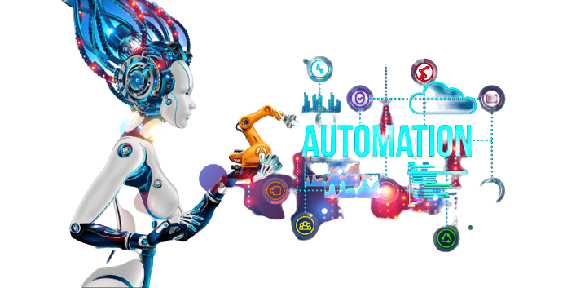
Why Automation?
Without automation...
Employee must spend time doing this tedious, mindless task manually on a regular basis
They are therefore left with less time to do complex, creative, or people-oriented tasks
We face the risk of being late in filing for tax returns
There is a stronger possibility for human error in our tax reconciliation
Multiple workers must devote their time in order to get through the workload
Key Metrics
Time per email
Time per reconciliation
Cost of late tax filings
Cost of erroneous reports
Cost of overtime
Number of employees needed for reconciliation
Opportunity cost for other tasks and innovation within company

Slide 6
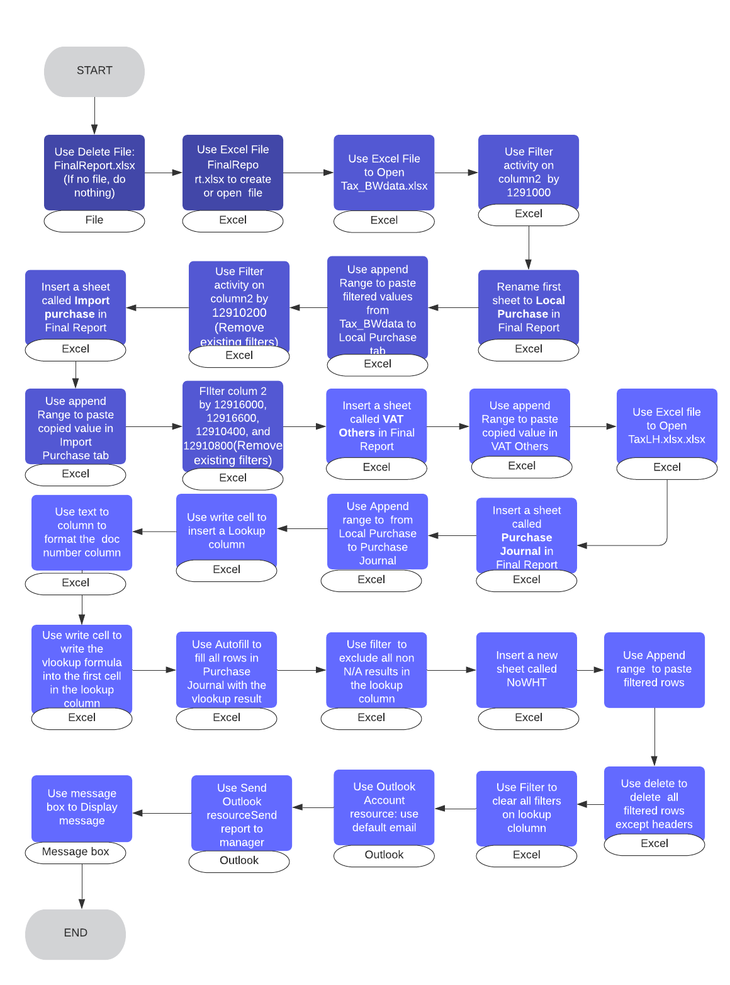
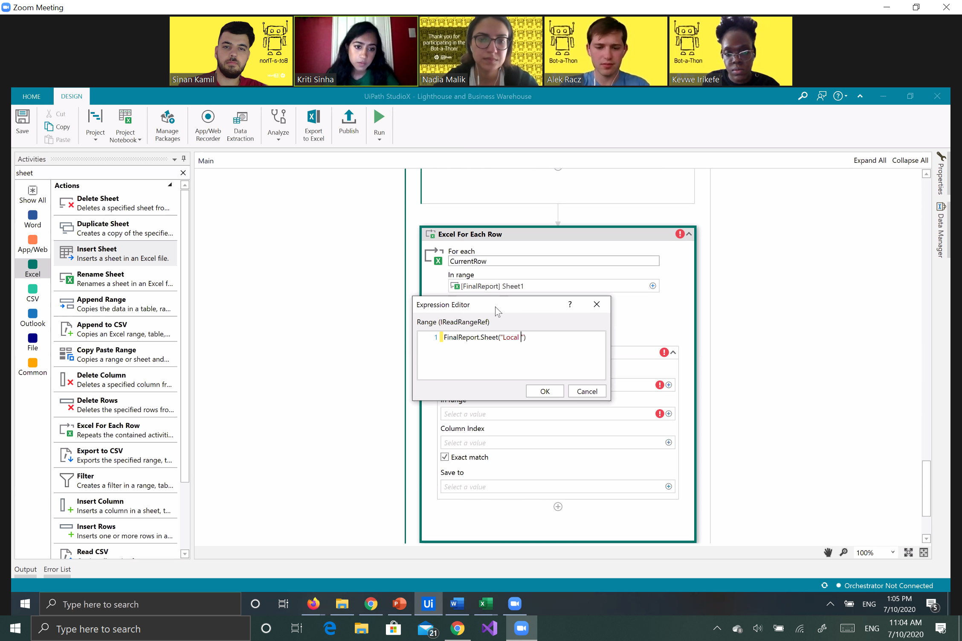
Automation Background - Robot Path
Left: A detailed flow chart containing each specific step performed by bot in this process
Above: Photo of Team 23 working to automate this process using RPA in UiPath StudioX

Slide 7


Demo Video
See our bot in action!
Click here if there are video issues!
<Embed the process video here>
See Notes for Do’s and Don’ts for Presentation

Slide 8
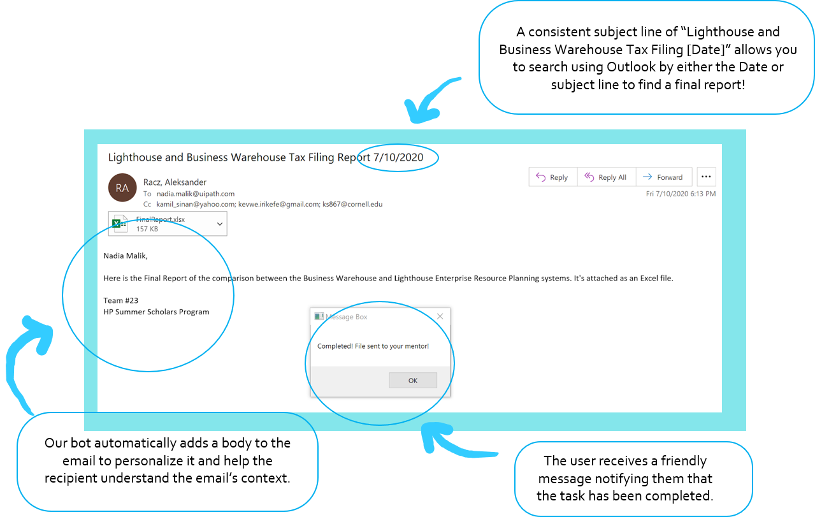
Special Features

Slide 9

Challenges Faced during Automation
During automation...
Human path workflow had to be translated into a robot path
Some dedicated activities were troublesome to use for the automation
Could not use VLookup in UiPath StudioX, replaced with Excel formula
Computer had to be in right state for automation to run
Excel had to be closed before automation could run
Despite facing these obstacles, our team completed the bot in just a few hours.
The results of our automation are outlined on the next slide.

Slide 10
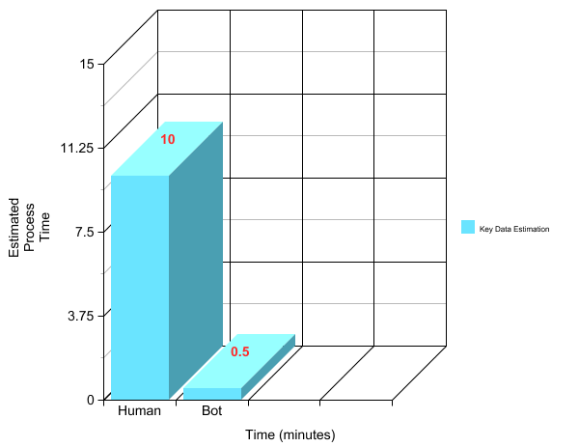


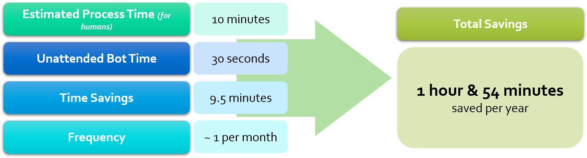



Key Data Estimation
Development Time (Hours) developing the bot
We were able to build out the process shown in the demo in 4.5 hours with a single developer
This bot can be reused for years
Proof Entry Process

Slide 11
Thank
You

